Slide 1
Section 6
Compute services
Dr Fatma Agery

Slide 2
Activity: Design a VPC
Scenario: You have a small business with a website that is hosted on an Amazon Elastic Compute Cloud (Amazon EC2) instance. You have customer data that is stored on a backend database that you want to keep private. You want to use Amazon VPC to set up a VPC that meets the following requirements:
Your web server and database server must be in separate subnets.
The first address of your network must be 10.0.0.0. Each subnet must have 256 total IPv4 addresses.
Your customers must always be able to access your web server.
Your database server must be able to access the internet to make patch updates.
Your architecture must be highly available and use at least one custom firewall layer.

Slide 3
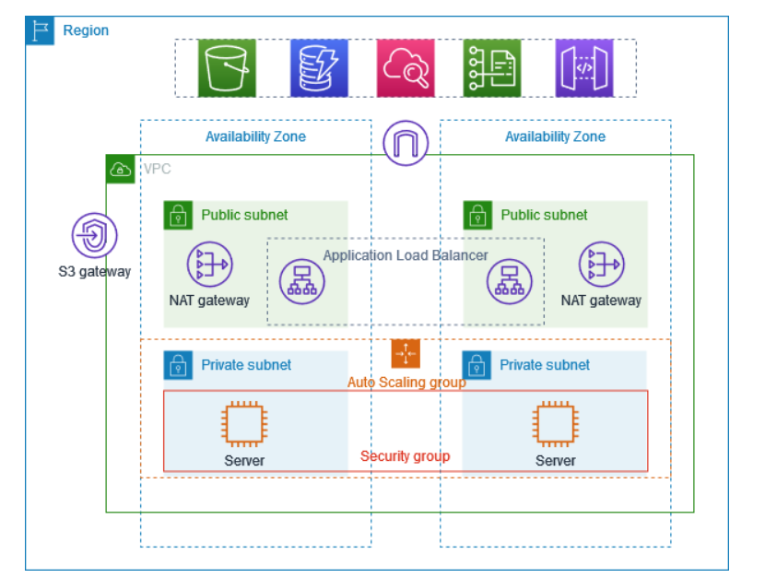
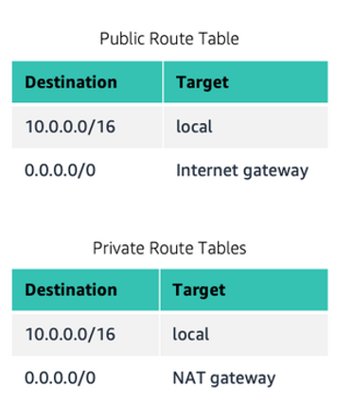

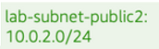
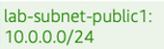
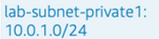
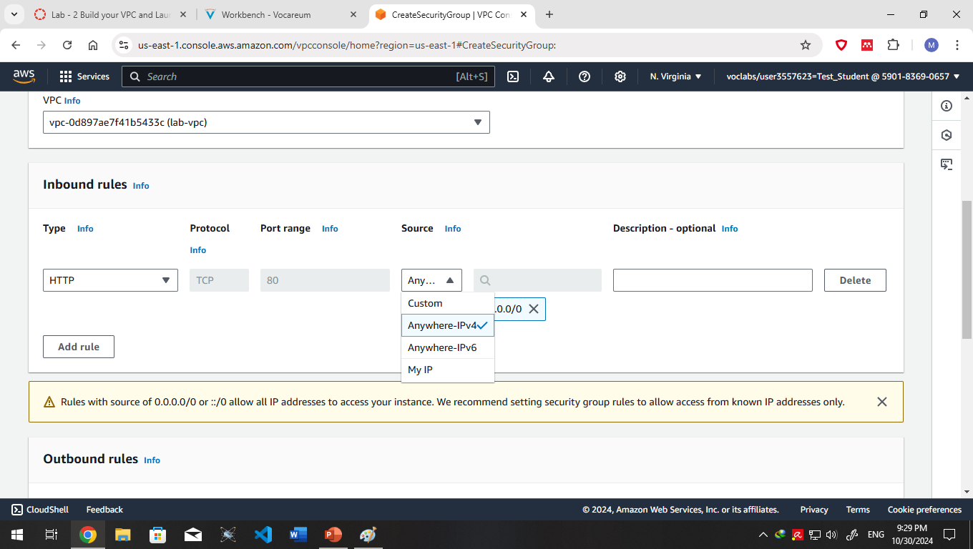
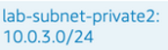

Slide 4
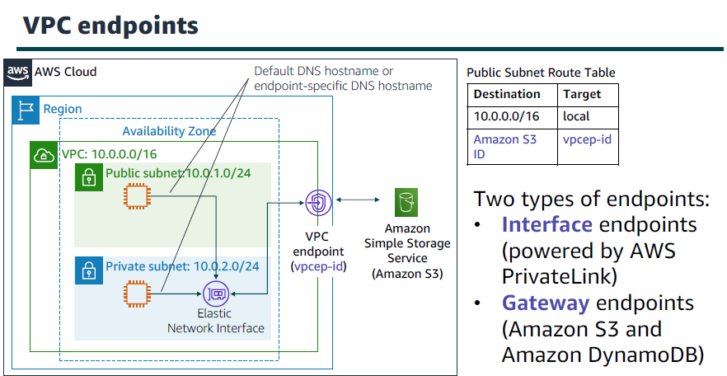

Slide 5
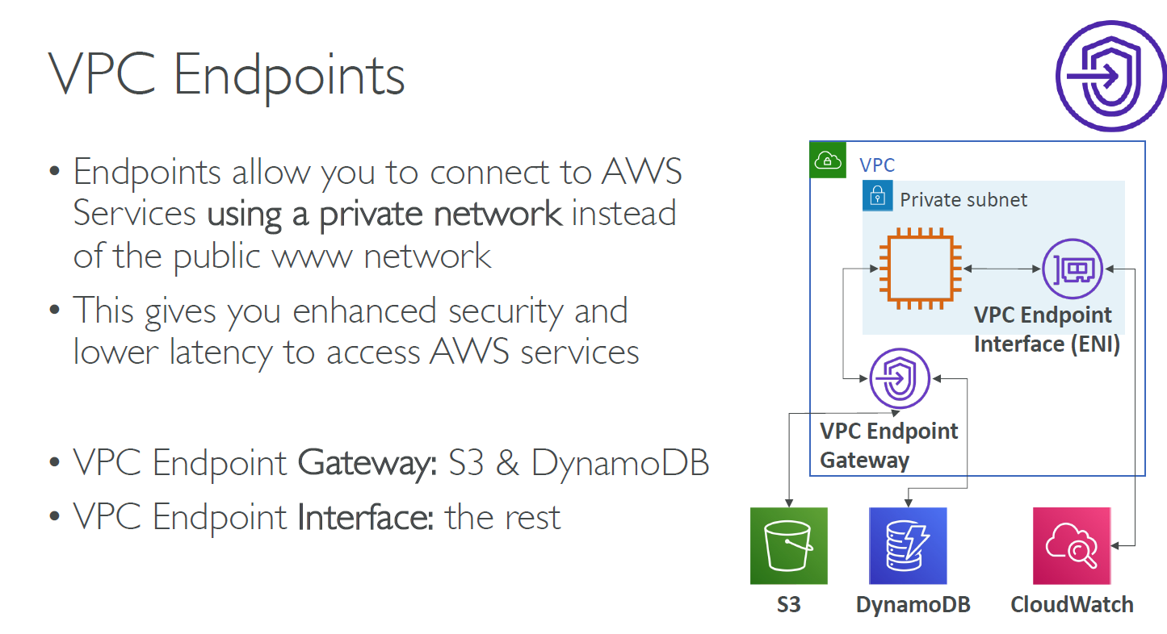

Slide 6
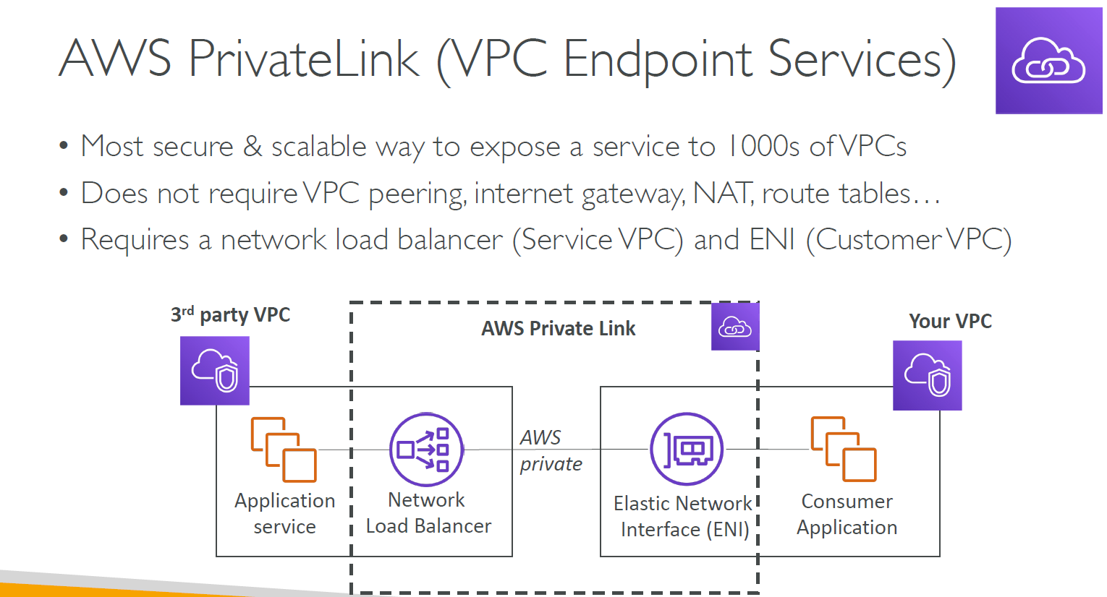

Slide 7
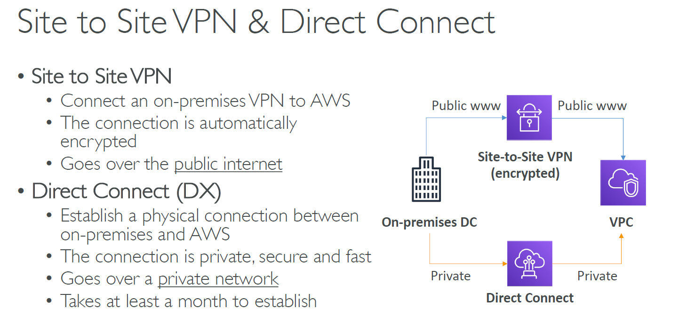

Slide 8
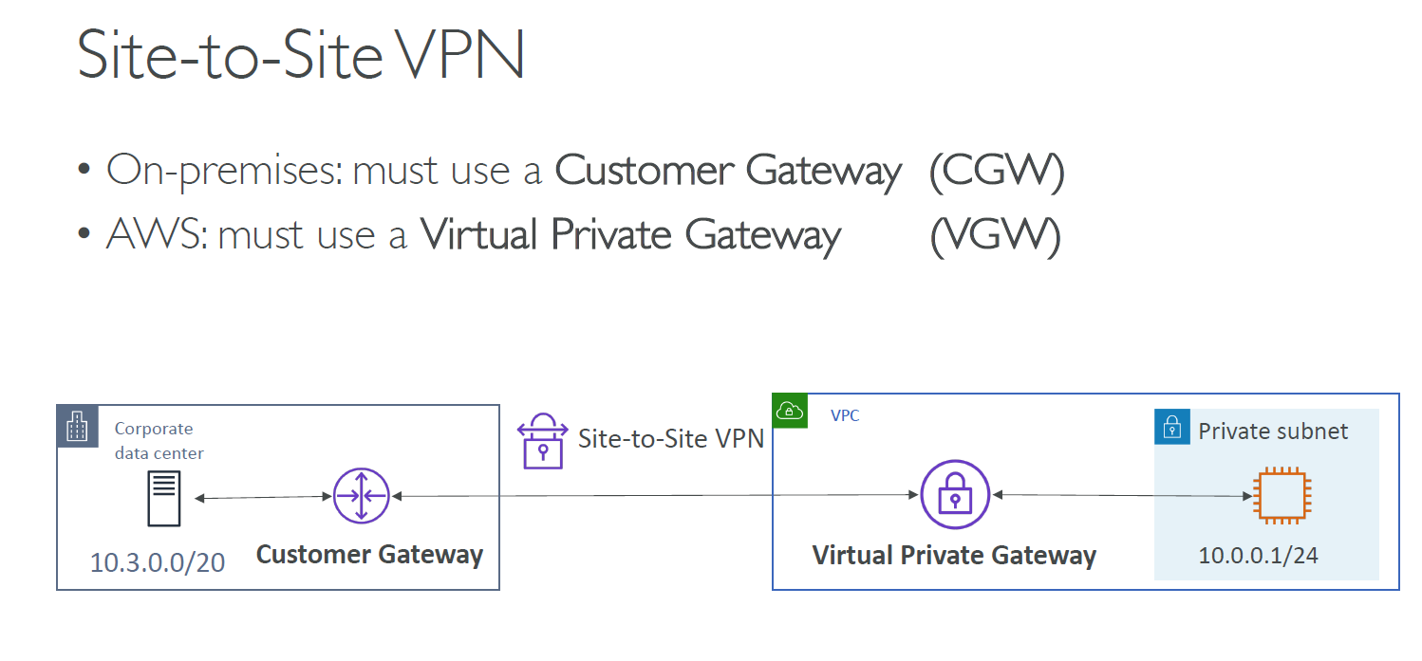

Slide 9
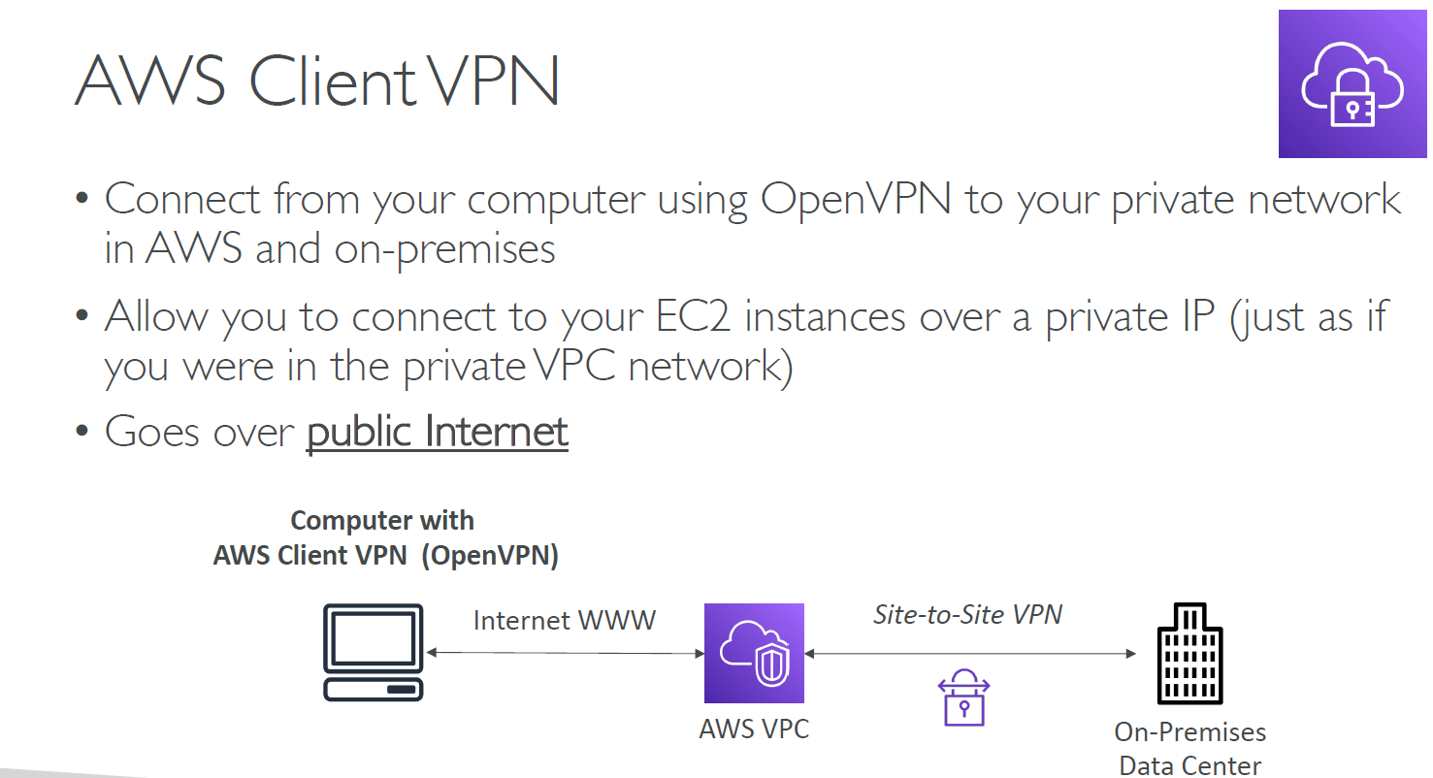

Slide 10
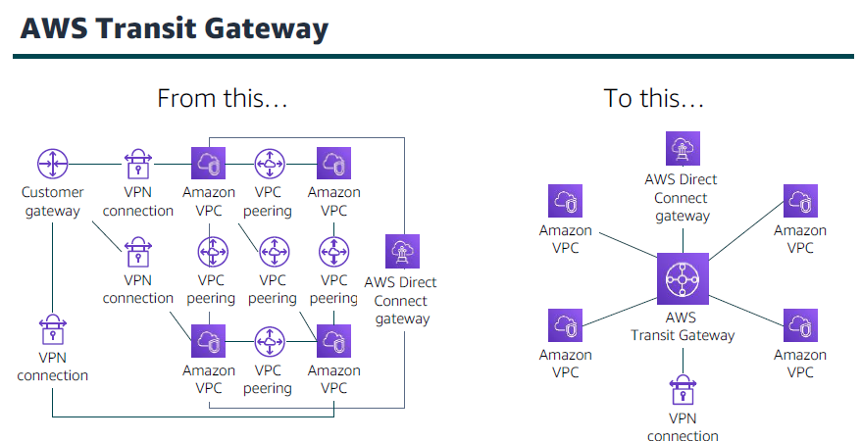

Slide 11
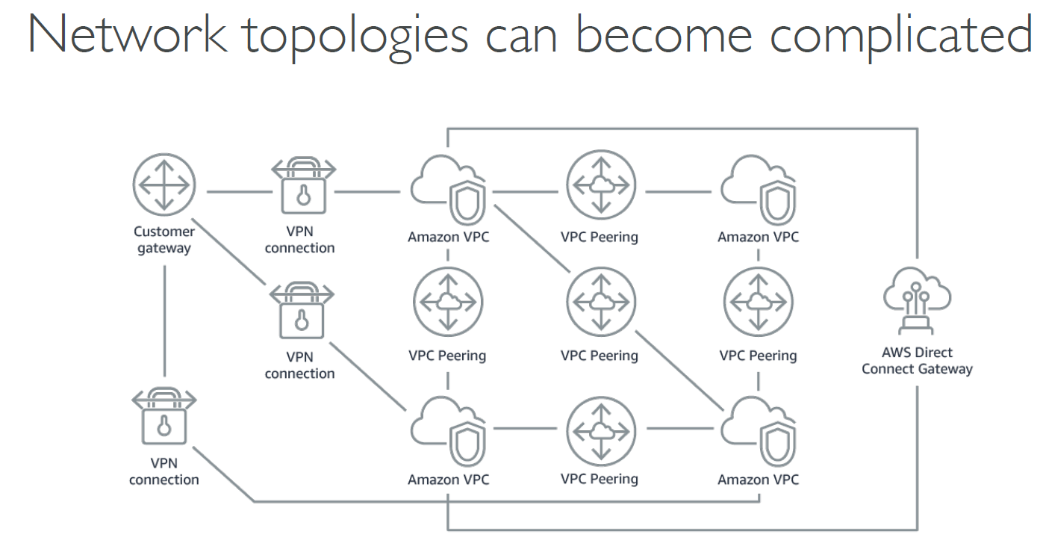

Slide 12
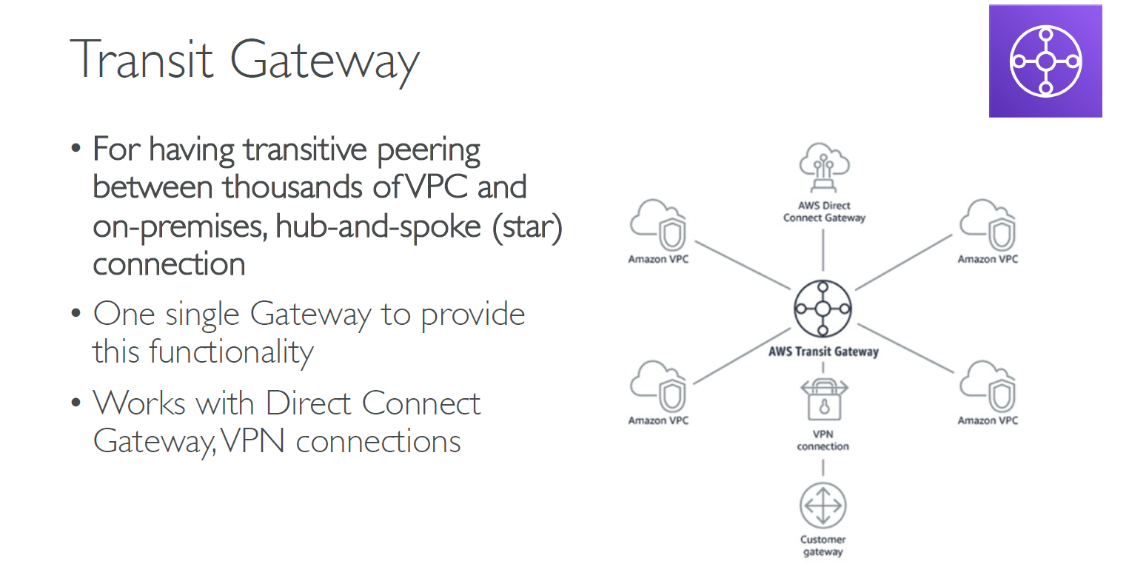

Slide 13
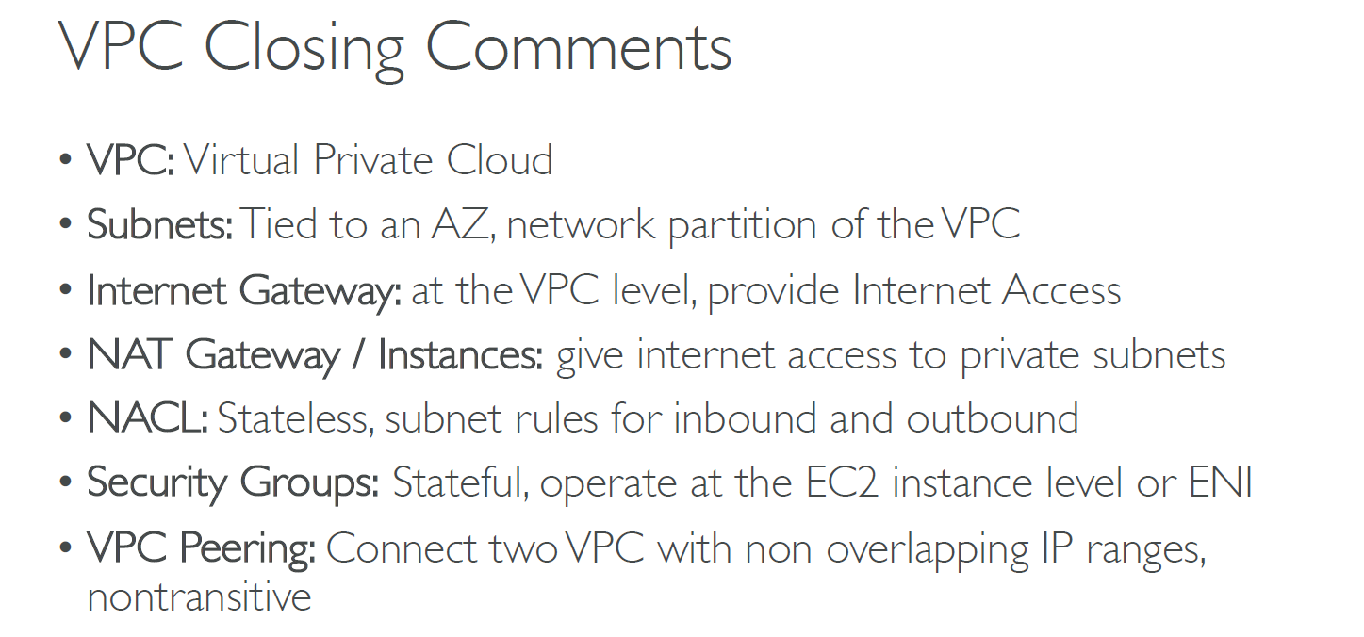

Slide 14
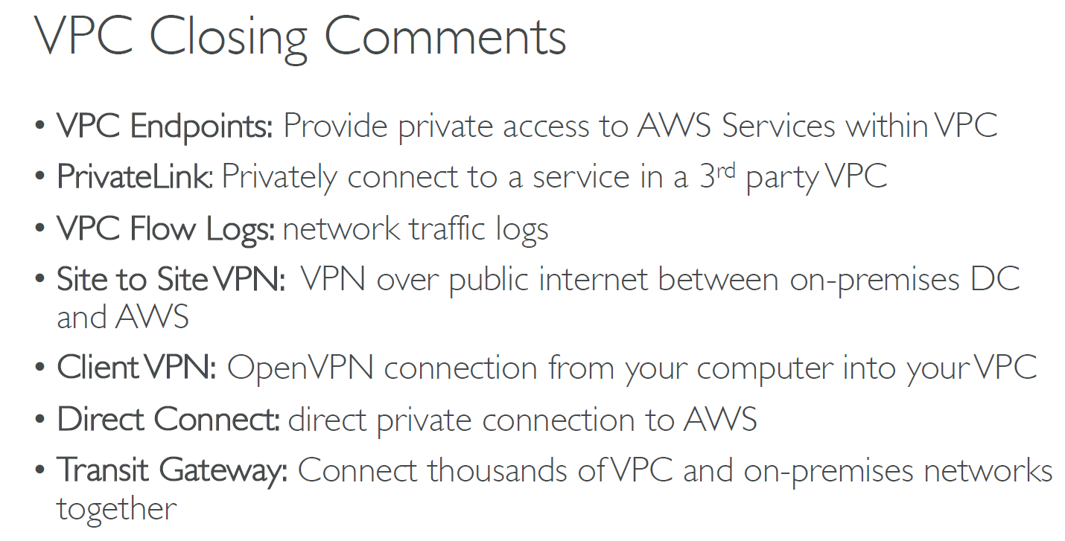

Slide 15
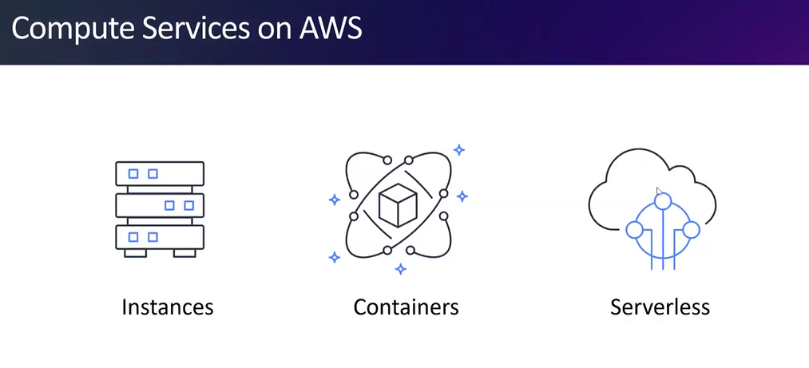

Slide 16
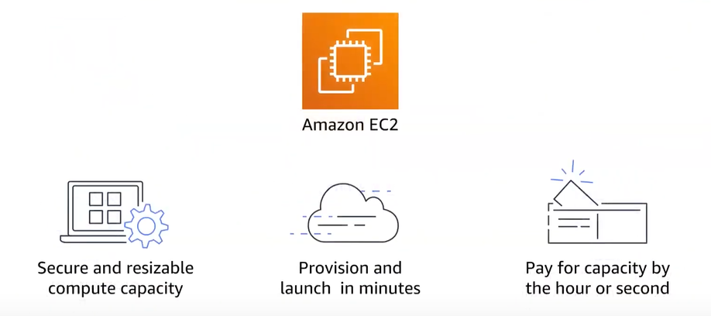

Slide 17
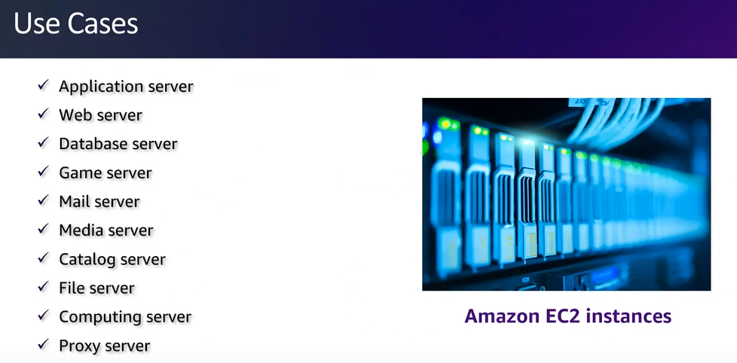

Slide 18

Amazon EC2
EC2 = Elastic Compute Cloud = Infrastructure as a Service
EC2 provides resizable virtual machines
Gives you full control over the guest operating system (Windows or Linux) on each instance

Slide 19
EC2 sizing & configuration options
Operating System (OS): Linux, Windows or Mac OS
How much compute power & cores (CPU)
How much random-access memory (RAM)
How much storage space
Network card: speed of the card, Public IP address
Firewall rules: security group
Bootstrap script (configure at first launch): EC2 User Data

Slide 20
EC2 Instance Types
You can use different types of EC2 instances that are optimized for different use cases
Naming convention:
m5.2xlarge
m: instance class
5: generation (AWS improves them over time)
2xlarge: size within the instance class

Slide 21
EC2 Instance Types
Instance Types:
General Purpose: Great for a diversity of workloads such as web servers (Balance between Compute, Memory, and Networking)
Compute Optimized: Great for compute-intensive tasks that require high performance processors
Memory Optimized: Fast performance for workloads that process large data sets in memory
Storage Optimized: Great for storage-intensive tasks that require high read and write access to large data sets on local storage

Slide 22
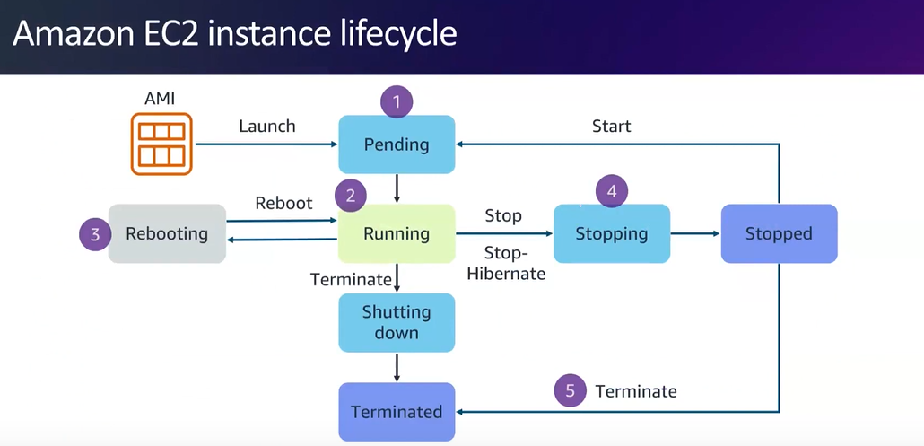

Slide 23
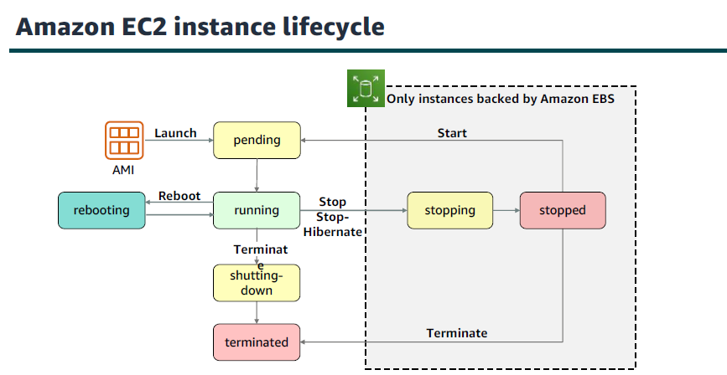

Slide 24
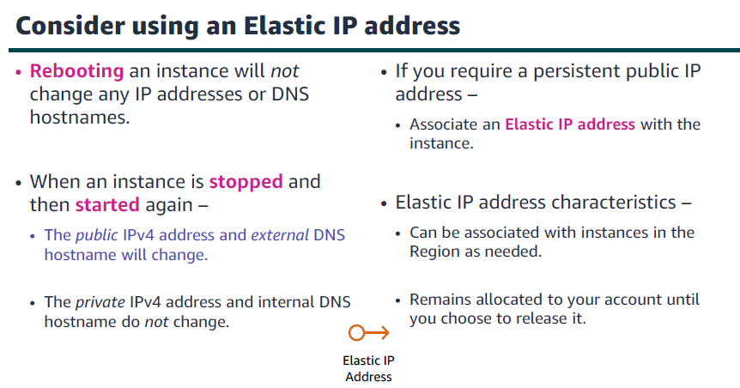

Slide 25
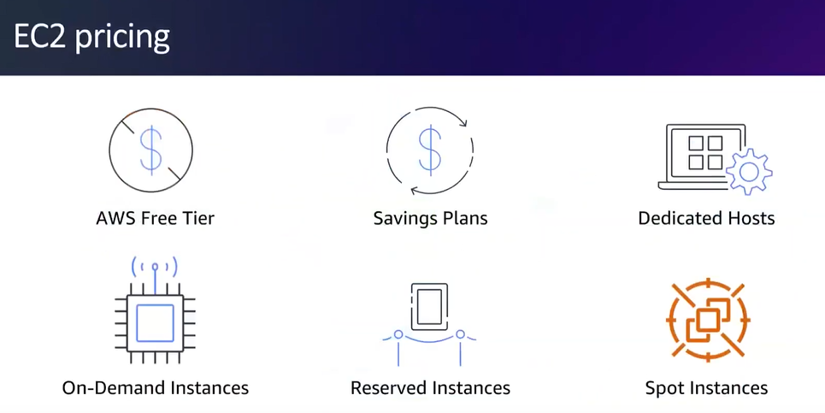

Slide 26

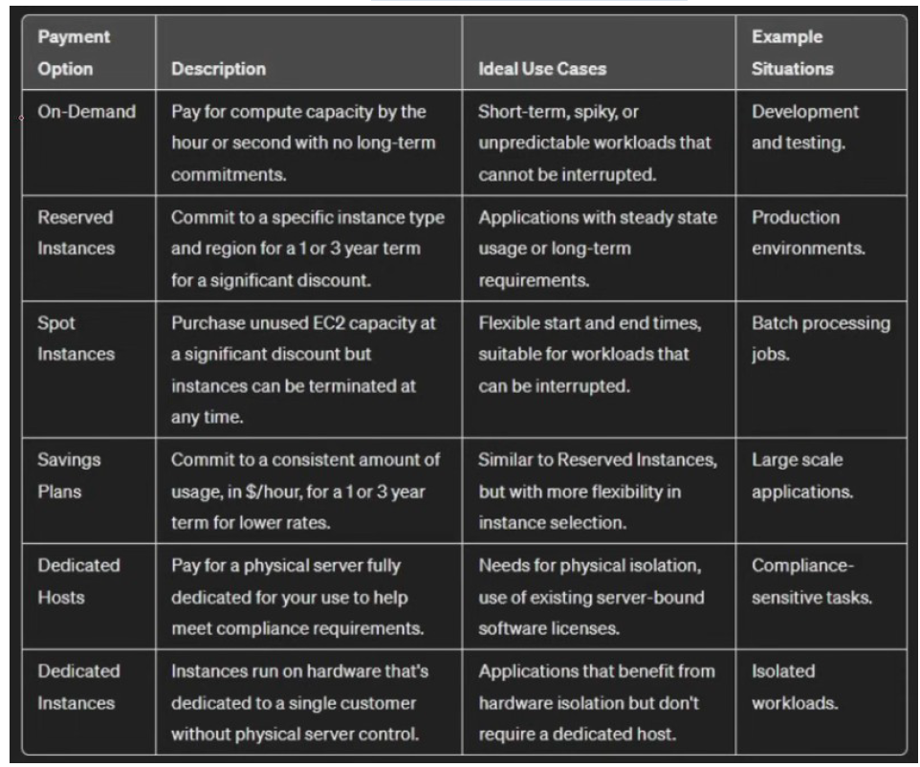

Slide 27
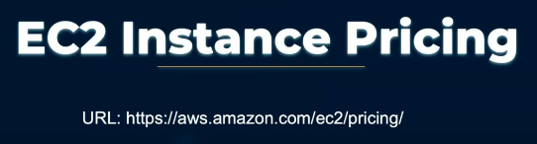
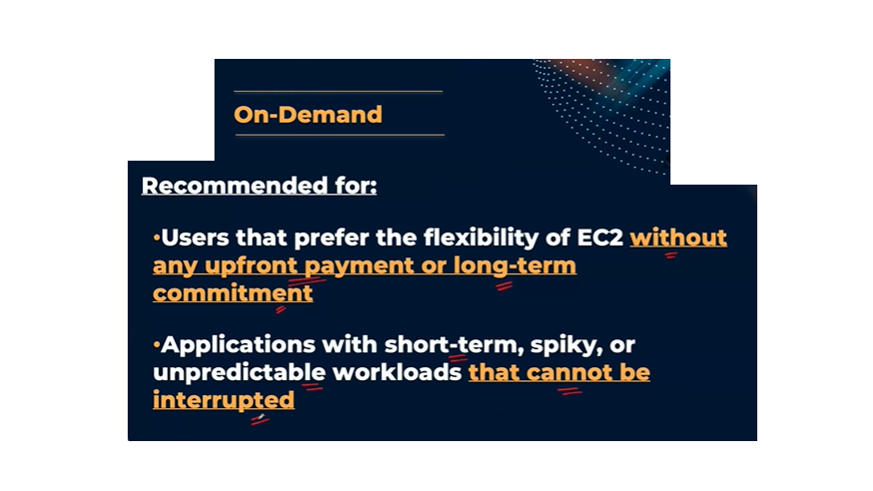

Slide 28
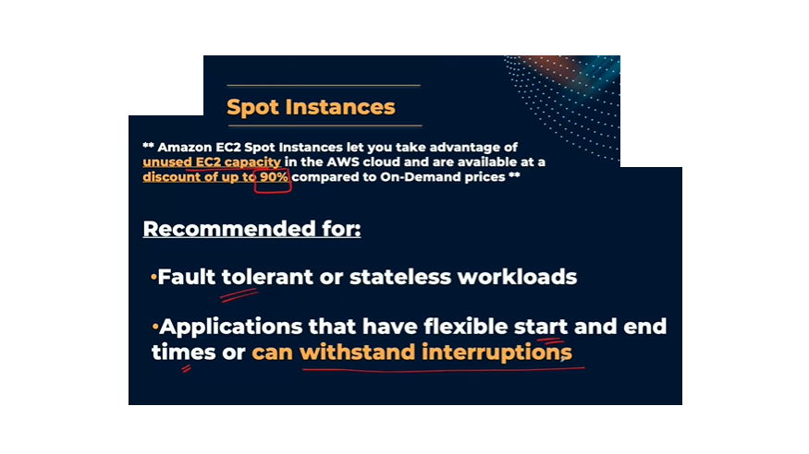

Slide 29
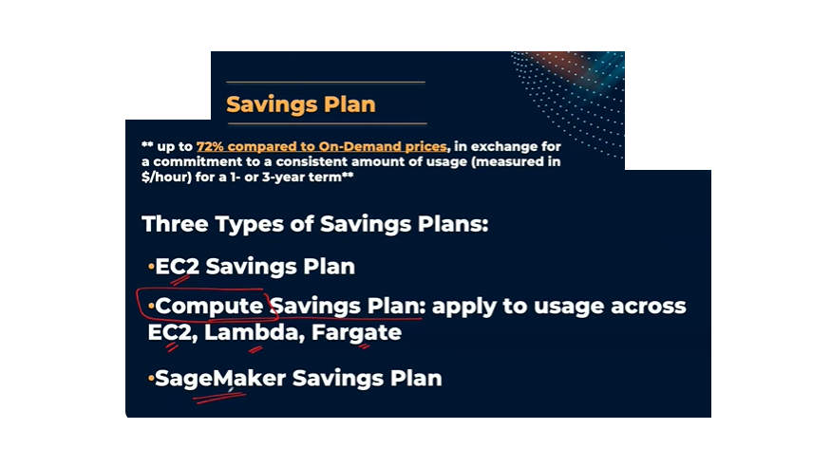

Slide 30
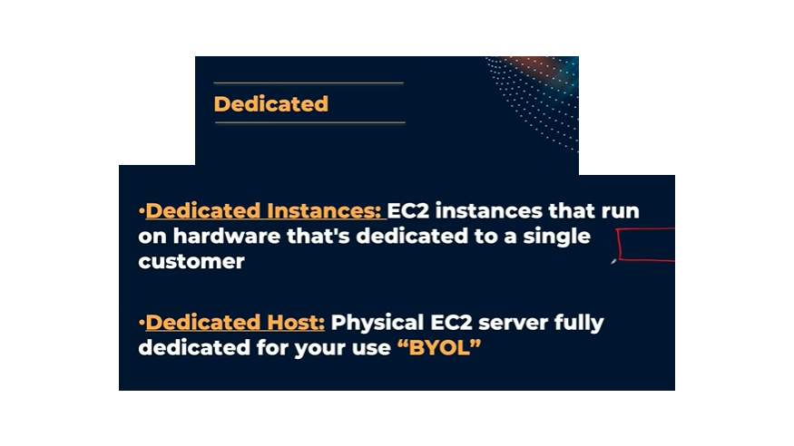

Slide 31
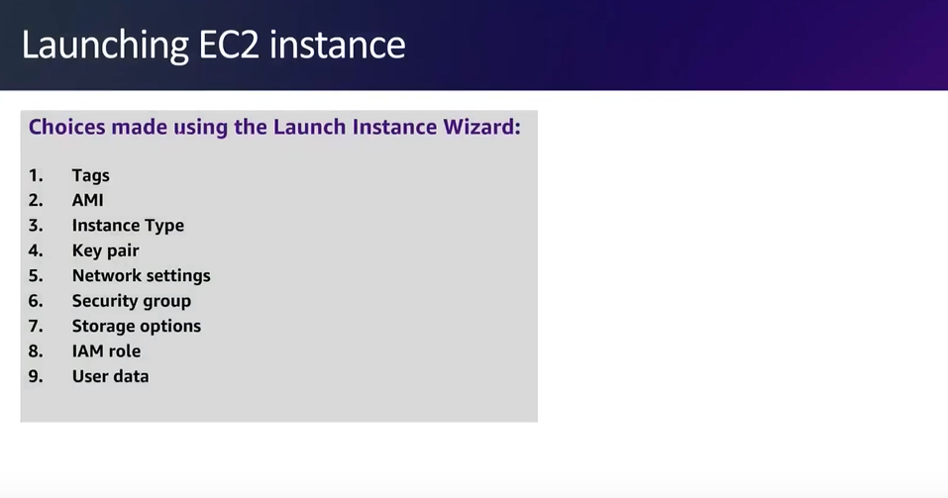

Slide 32
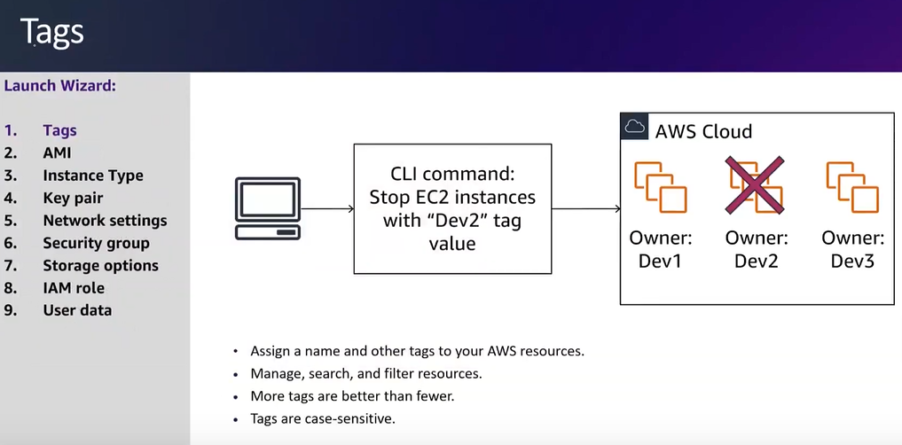

Slide 33
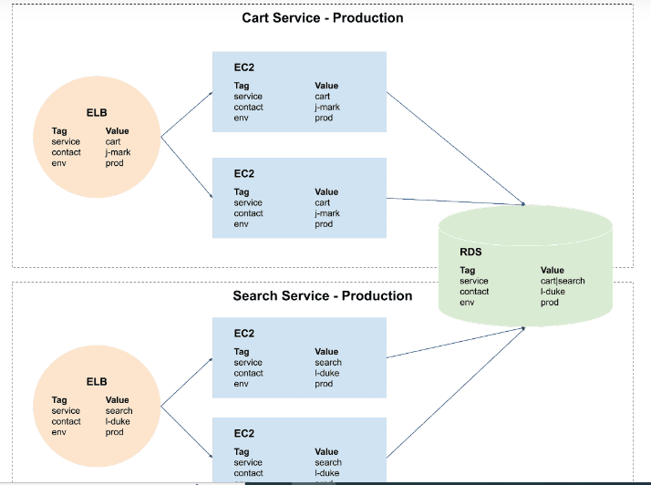

Slide 34
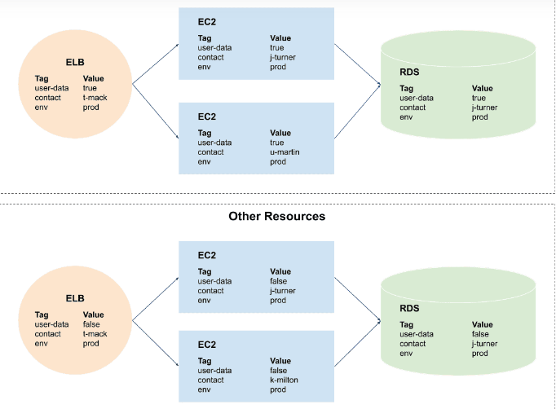

Slide 35
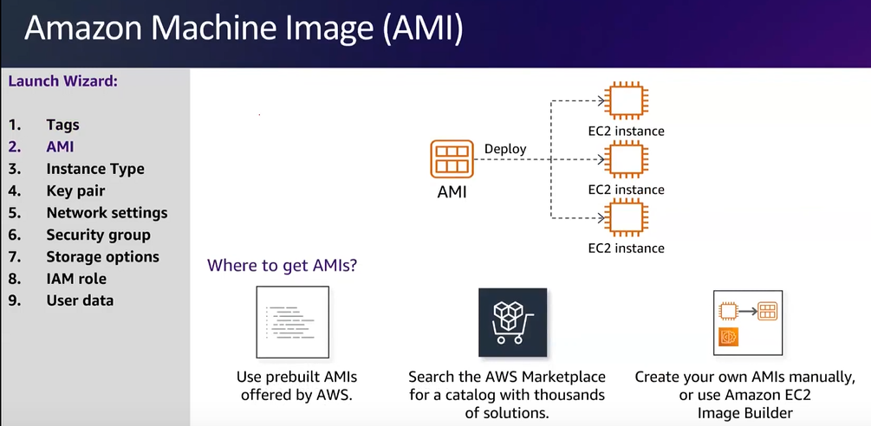

Slide 36
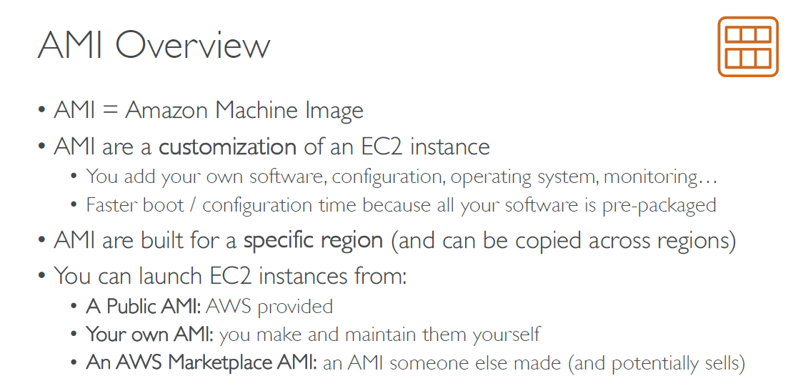

Slide 37
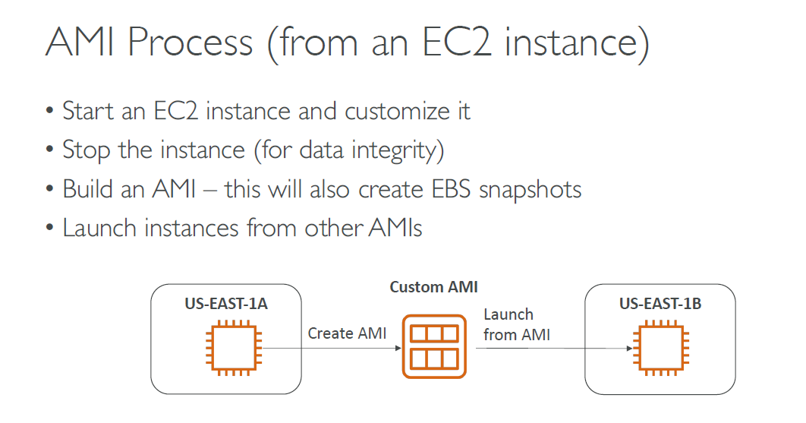

Slide 38
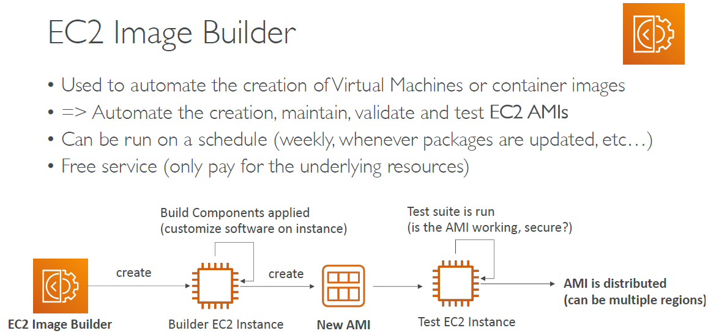

Slide 39
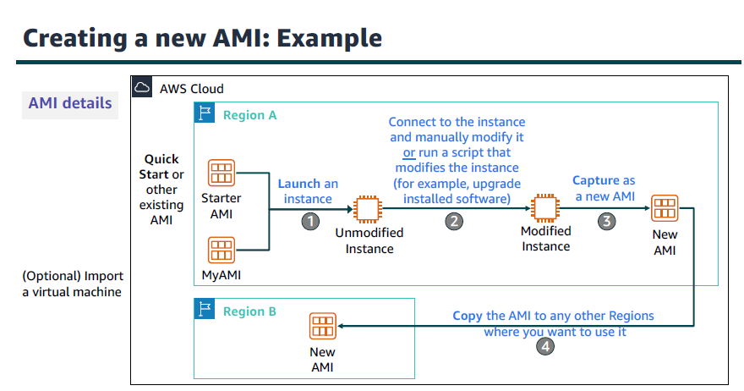

Slide 40
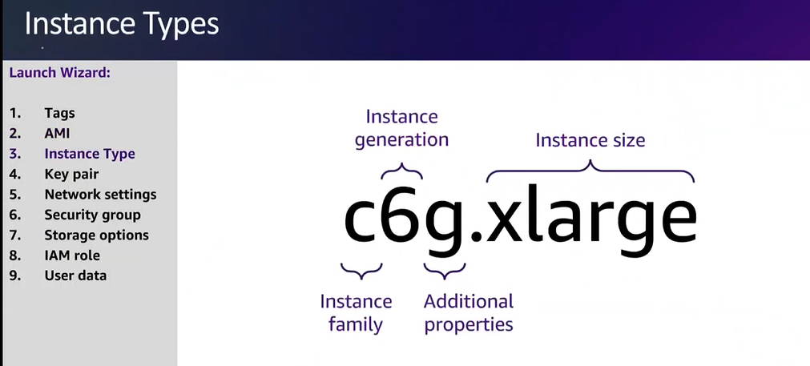

Slide 41
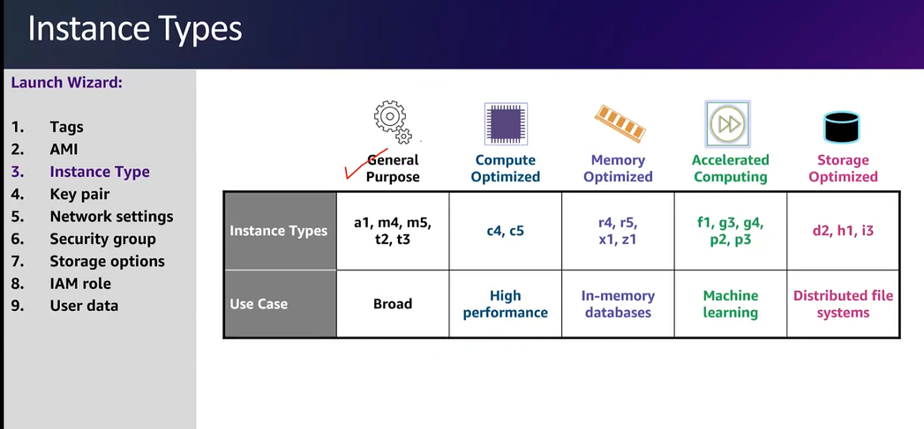

Slide 42
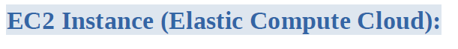
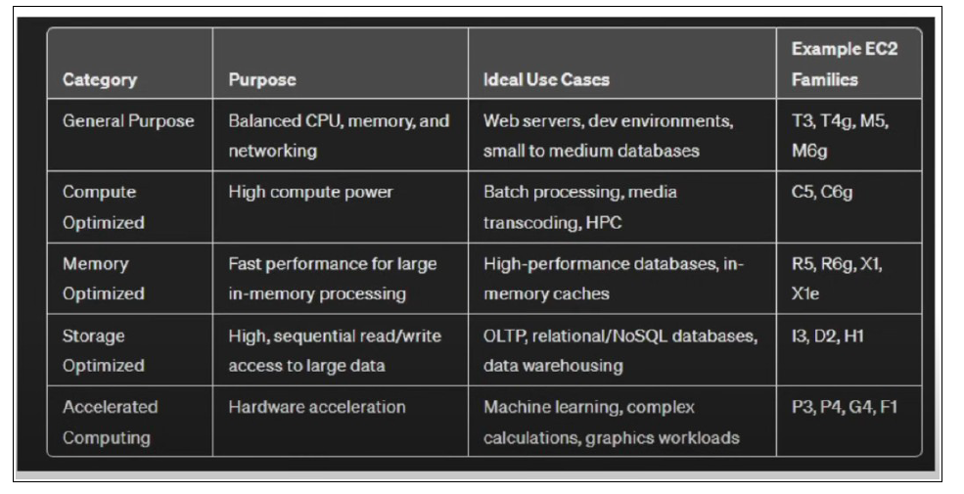

Slide 43
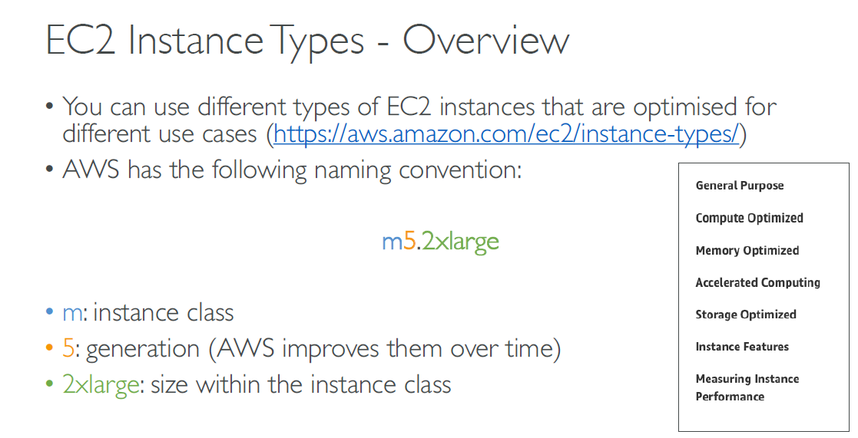

Slide 44
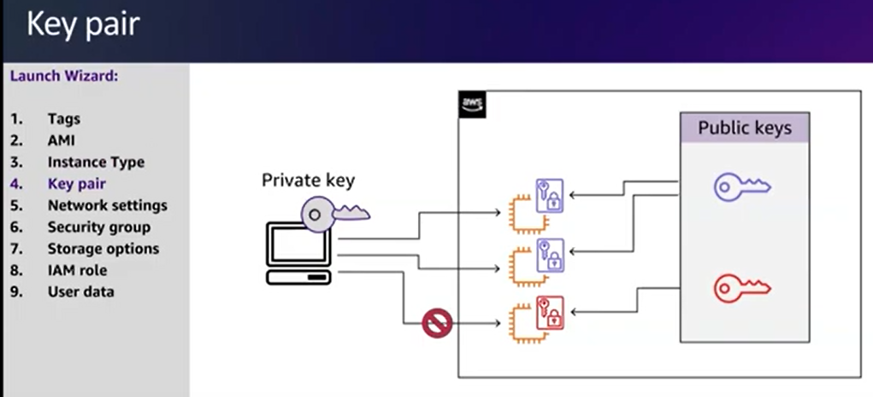

Slide 45
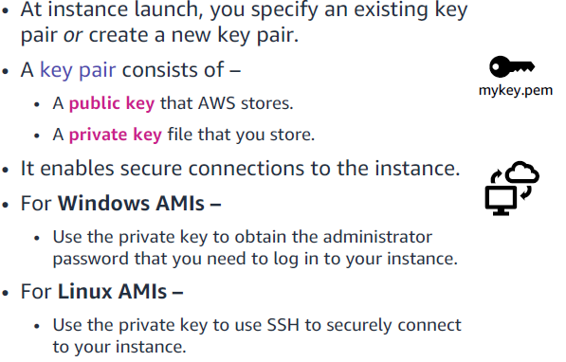

Slide 46
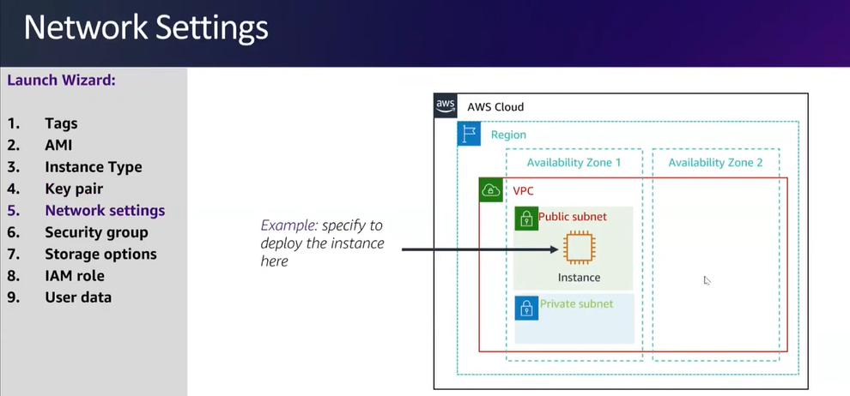

Slide 47
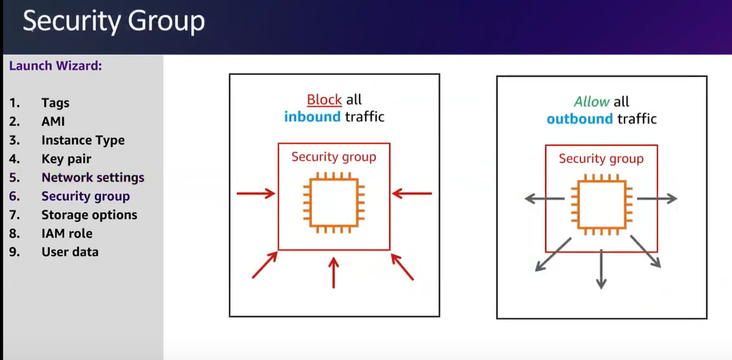

Slide 48
Add a new Inbound Rule, Type: HTTP,
Source: Any IPv4

Slide 49
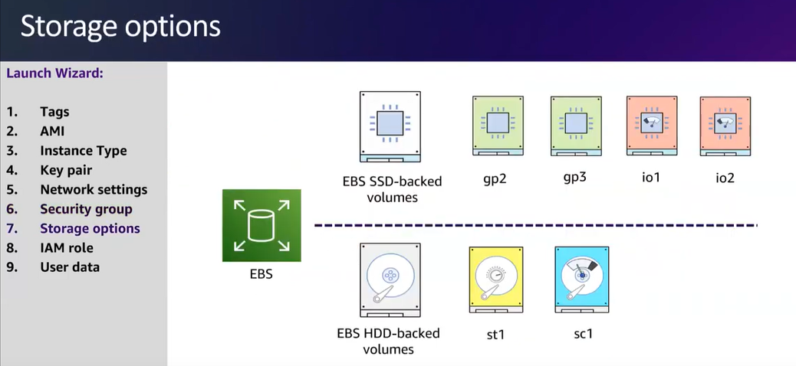

Slide 50


Slide 51


Slide 52


Slide 53


Slide 54


Slide 55


Slide 56


Slide 57
Activity: Check your understanding
1- Between Amazon EC2 or Amazon RDS, which provides a managed service? What does managed-service mean?
ANSWER: Amazon RDS provides a managed service. Amazon RDS handles provisioning, installation and patching, automated backups, restoring snapshots from points in time, high availability, and monitoring.
2- Name at least one advantage of deploying Microsoft SQL Server on Amazon EC2 instead of Amazon RDS.
ANSWER: Amazon EC2 offers complete control over every configuration, the OS, and the software stack.

Slide 58
Activity: Check your understanding
3- What advantage does the Quick Start provide over a manual installation on Amazon EC2?
ANSWER: The Quick Start is a reference architecture with proven best practices built into the design.
4- Which deployment option offers the best approach for all use cases?
ANSWER: Neither. The correct deployment option depends on your specific needs.
5- Which approach costs more: using Amazon EC2 or using Amazon RDS?
ANSWER: It depends. Managing the database deployment on Amazon EC2 requires more customer oversight and time. If time is your priority, then Amazon RDS might be less expensive. If you have in-house expertise, Amazon EC2 might be more cost-effective.

Slide 59


Slide 60


Slide 61


Slide 62

Open EC2 Service

Slide 63

Launch Instance

Slide 64

Leave the OS setting at default

Slide 65

Leave instance type as t2.micro

Slide 66

Edit the Network Settings

Slide 67

Choose the VPC, and Subnet

Slide 68

Create a new Security Group

Slide 69

Configure the name and description

Slide 70

Remove the Existing Inbound Rule

Slide 71

Leave the Storage Configuration at default

Slide 72

Expand Advanced Details, Enable Termination Protection

Slide 73

Paste the script into User data, and Launch the Instance

Slide 74

Wait until the initialization phase is complete

Slide 75

Go to Status and Alarms, you can view the status of the instance

Slide 76

Go to Monitoring

Slide 77

You can Enlarge any graph

Slide 78

CPU utilization Graph

Slide 79

Go to System log

Slide 80

The System log is displayed

Slide 81

Get Instance Screenshot

Slide 82

Instance Screenshot

Slide 83

Copy the Public IPv4 Address

Slide 84

The Server Cannot be reached

Slide 85

Edit Security Group to enable HTTP requests

Slide 86

Edit Inbound rules

Slide 87

Add Rule

Slide 88

Allow HTTP traffic From anywhere

Slide 89

The web page is reachable

Slide 90

Stop the Instance

Slide 91

Wait for the instance to enter “Stopped” state

Slide 92

Change instance type

Slide 93

Choose t2.small

Slide 94

Change Stop Protection

Slide 95

Enable Stop Protection

Slide 96

Go to Storage

Slide 97

Select the Volume ID

Slide 98

Modify the Volume

Slide 99

Resize the volume to 10 GiB

Slide 100

Start the Instance after modification

Slide 101

Go to Service Quotas

Slide 102

In AWS services, Search for ec2

Slide 103

Search for running on-demand, you can see the quota limits

Slide 104

Stop the Instance

Slide 105

You cannot stop the instance because of the stop protection

Slide 106

Chance stop protection

Slide 107

Disable the stop protection

Slide 108

Try to stop the instance again

Slide 109

Successfully stopped

Slide 110
Questions
1- Which network security tool can you use to control traffic in and out of EC2 Instances?
Network Access Control Lists (NACL)
Identity and Management Access (IAM)
GuardDuty
Security Groups
Notes:
D. Security Groups

Slide 111
Questions
2- Under the Shared Responsibility Model, who is responsible for operating-system patches and updates on EC2 Instances?
The Customer
AWS
Both AWS and the Customer
Notes:
A. The Customer

Slide 112
Questions
3- A company would like to deploy a high-performance computing (HPC) application on EC2. Which EC2 instance type should it choose?
Storage Optimized
Compute Optimized
Memory Optimized
General Purpose
Notes:
B. Compute Optimized

Slide 113
Questions
4- EC2 is a Platform as a Service (PaaS)
True
False
Notes:
B. False

Slide 114
Questions
5- Under the Shared Responsibility Model, AWS is responsible for configuring Security Groups rules?
True
False
Notes:
B. False

Slide 115

Notes:
Amazon EC2 instances can be launched on-demand when needed.

Slide 116

Notes:
Scheduled Reserved Instances

Slide 117

Notes:
All of the above

Slide 118

Notes:
Dedicated Instances

Slide 119

Notes:
Run four On-Demand Instances constantly, then add eight more On-DemandInstances on the last day of each month.

Slide 120

Notes:
Reserved instance

Slide 121

Notes:
ID
password

